Slide 1
Words Matter: The Vocabulary of Racism/Antiracism
October 11, 2020

Slide 2
Why Is Focusing on Antiracism Important?
We historically redefine good and evil to our own advantage at the expense of others.
There is a history of this. Even the redeemed people of Isreal went on to commit the same acts of injustice against the vulnerable (Not to mention our own lives)
As believers in Christ, antiracism isn’t about politics. It’s about standing up for our brothers and sisters of color and condemning hatred. Jesus encourages us to fight injustice toward the vulnerable.
We are all made in the image of God and should treat each other as such.
Our tradition teaches of reconciliation and restorative justice. This means taking steps to advocate for the vulnerable and changing social structures to prevent injustice.
Notes:
Genesis 1:27
Psalm 139:13-14
Psalm 146:7-9
Proverbs 31:8-9
Jeremiah 22:3
Amos 5:21-24
Micah 6:8
Acts 10:34-35
1 Corinthians 12
Romans 12:9-13

Slide 3
The Bible Tells Us
Micah 6:8 “And what does the LORD require of you But to do justice, to love kindness, And to walk humbly with your God?”
Proverbs 31:8 “Open your mouth for those who cannot speak for themselves, for the rights of all who are destitute.”
Jeremiah 22:3 “Thus says the Lord: Act with justice and righteousness and deliver from the hand of the oppressor anyone who has been robbed. And do no wrong or violence to the alien, the orphan, and the widow, or shed innocent blood in this place.”
Genesis 1:27, Psalm 139:13-14, Psalm 146:7-9, Amos 5:21-24, Acts 10:34-35, 1 Corinthians 12, Romans 12:9-13

Slide 4
Why Do We Need a Common Language?
To understand racism, we need to all be on the same page so we can “name it, frame it and explain it.”
Having a shared language to present data, describe conditions and outcomes, and identify causes, makes it easier to understand each other, and avoid misunderstanding.
We want to support each other on this journey.

Slide 5
IF WE AREN’T CLEAR ON THE WORDS AND IDEAS, HOW CAN WE BE CLEAR ON THE SOLUTIONS?

Slide 6
Acceptance is appreciating and welcoming others for who they are as individuals without judgment. When we accept someone, it shows that we value and respect their identity.
Using appropriate and respectful language helps those around you feel included, and can set an example for the people you come into contact with
Every day, we have the ability and opportunity to create a more accepting world. Even small acts of inclusion can have a big impact on making others feel accepted.
Our goal is the active process of identifying and eliminating racism by changing systems, organizational structures, policies, practices and attitudes, so that power is shared equitably.

Slide 7
Antiracism
Antiracism - A theory that explains and exposes multiple forms of racism: overt and covert, interpersonal and institutional, historical and present day, persistent and emerging. It is the practice of dismantling a system marked by white supremacy and anti-Black racism through deliberate action

Slide 8
ANTIRACISM
To be antiracist is to think nothing is behaviorally wrong or right -- inferior or superior -- with any of the racial groups. Whenever the antiracist sees individuals behaving positively or negatively, the antiracist sees exactly that: individuals behaving positively or negatively, not representatives of whole races. To be antiracist is to deracialize behavior, to remove the tattooed stereotype from every racialized body. Behavior is something humans do, not races do.“
Ibram X. Kendi, How to Be an Anti-Racist

Slide 9
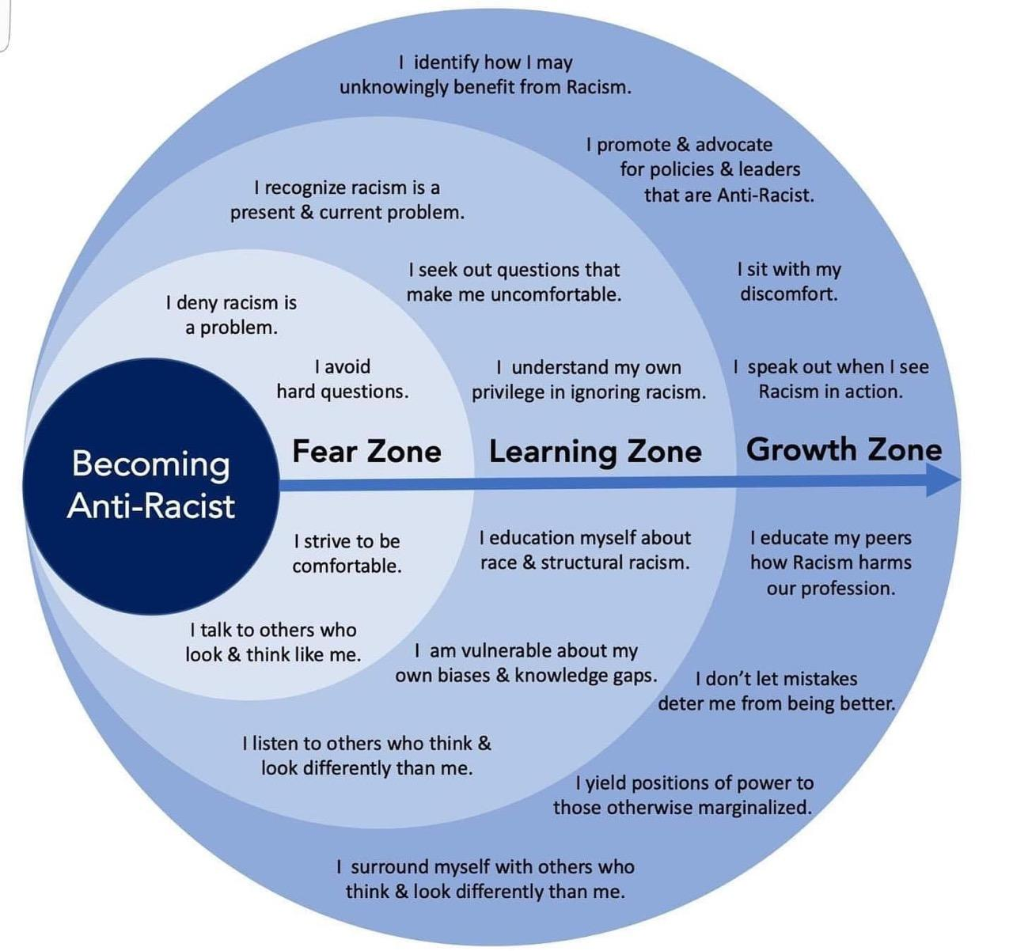
The Journey
The Zones
Self-Reflection
Growth
We recognize that everyone may not be in the same place and respect that

Slide 10
Definitions
Adapted From:
“Stay Woke: A People’s Guide to Making All Black Lives Matter”
by Candis Watts Smith and Tehama Lopez Bunyasi
“How to Be an Anti-Racist” by Ibram X. Kendi,
Anti-Defamation League Education Glossary Terms, 2018

Slide 11
Racism
Racism is the marginalization, oppression and discrimination against people of color based on a socially constructed racial hierarchy that privileges white people.
Racism includes blaming an individual or group for something based on that person or group’s identity when the person or group is not responsible.

Slide 12
Racism is a feature of a society, which serves to perpetuate social, political, and economic inequities between racial groups. In the US, it is the array of anti-black (anti-BIPOC) practices, policies, and ever-perpetuated inequalities that maintain white privilege and power over people of color.

Slide 13
Racism is prejudice plus power
In North America, white people are favored. They have institutional power.
Racism is a systematized discrimination or antagonism directed against people of color based on the belief that whiteness is better.
A common, incorrect definition of racism is that racism is prejudice against someone based on their skin color or ethnicity and can be committed by anyone. This is NOT an accurate definition as it solely highlights an individual’s' thinking and actions but ignores embedded institutional and cultural systems.
Notes:
racism
1. A feature of a society, whereby patterns of public policy, institutions, dominant ideologies, and popular representations serve to perpetuate social, political, a
racism
1. A feature of a society, whereby patterns of public policy, institutions, dominant ideologies, and popular representations serve to perpetuate social, political, and economic inequities between racial groups
2. The array of anti-Black practices, policies, and ever-perpetuated inequalities that maintain white privilege and power

Slide 14
Racism can be:
Three ways racism
manifests…
Institutional
Interpersonal
Internalized
Notes:
This system affects individuals, institutions and informs our culture. Again, we’ll get into more of this with the article we’re going to read, but I want to see if we can name some examples.
Individual: getting a job, friend groups, hair, clothing
Institutional: healthcare, education, criminal justice system, employment
Cultural: aethetics, art, language, competencies
11:31 Jaime-Jin
Racism manifests itself in many forms. Let’s learn some vocabulary because this is on the of the tools we want to give you (define, give examples, ask for examples).
Racism shapes individual, institutional and cultural experience. (call out examples)
Individual (attitudes, behaviors, socialization, self-interest)
Institutional (education, health, legal system, housing, labor)
Cultural (values, beliefs, philosophy, arts, aesthetics, ideologies)

Slide 15
Redlining
School to Prison Pipeline
The way racism manifests itself within various institutions in society. This includes the policies and practices that perpetuate a cycle of racial inequity and are promoted (overtly or subtly) by institutions (i.e. schools, government, housing, media).
Institutional
Racism
Media
Stop and Frisk
Food Deserts
Notes:
This system affects individuals, institutions and informs our culture. Again, we’ll get into more of this with the article we’re going to read, but I want to see if we can name some examples.
Individual: getting a job, friend groups, hair, clothing
Institutional: healthcare, education, criminal justice system, employment
Cultural: aethetics, art, language, competencies
11:31 Jaime-Jin
Racism manifests itself in many forms. Let’s learn some vocabulary because this is on the of the tools we want to give you (define, give examples, ask for examples).
Racism shapes individual, institutional and cultural experience. (call out examples)
Individual (attitudes, behaviors, socialization, self-interest)
Institutional (education, health, legal system, housing, labor)
Cultural (values, beliefs, philosophy, arts, aesthetics, ideologies)

Slide 16
School Discipline
Language
Multiculturalism Vs. Anti-Racism
Consciously or subconsciously discriminating against a person or a group simply because of their race.
This is usually manifested through communication (verbal or non-verbal) or actions. It occurs when those with racial privilege (White people) discriminate against, isolate, minimize the experience of or oppress those with no (historical) structural power (People of Color).
Interpersonal
Racism
Social Exclusion
Microaggressions
Financial Aid Assumptions
Notes:
This system affects individuals, institutions and informs our culture. Again, we’ll get into more of this with the article we’re going to read, but I want to see if we can name some examples.
Individual: getting a job, friend groups, hair, clothing
Institutional: healthcare, education, criminal justice system, employment
Cultural: aethetics, art, language, competencies
11:31 Jaime-Jin
Racism manifests itself in many forms. Let’s learn some vocabulary because this is on the of the tools we want to give you (define, give examples, ask for examples).
Racism shapes individual, institutional and cultural experience. (call out examples)
Individual (attitudes, behaviors, socialization, self-interest)
Institutional (education, health, legal system, housing, labor)
Cultural (values, beliefs, philosophy, arts, aesthetics, ideologies)

Slide 17
Bias- A preference for or against an individual or group that interferes with or influences fair judgment. Bias can be both conscious and unconscious.
Implicit Bias - The assumptions, stereotypes, and unintentional actions (positive or negative) we make towards others based on identity labels (like race, religion, age, gender, sexual orientation, or ability.) Because our implicit associations are stored in our subconscious, we may act on our biases without even realizing it. Often, our implicit biases contradict our values
Equity - Equity is when everyone gets what they need in order to have access, opportunities, and a fair chance to succeed. Equity recognizes that the idea of equality (“the same for everyone”) may not address widespread disparities and individual circumstances where individualized solutions are necessary
Marginalization - The process of putting or keeping someone (or a group of people) in a powerless position within a society by not giving them an active voice, identity, or place within it. This can show up in subtle or overt actions, such as using derogatory language, assuming someone’s accomplishments are not based on merit, and expecting individuals to act a certain way based on stereotypes.
Notes:
1) In addition to understanding and correcting our implicit bias, we must also look outward to examine how our systems and structures advantage some groups and disadvantage others. Our systems and environments -- from schools to workplaces to communities -- have been impacted by and have contributed to forms of systemic oppression
2)Equity - Equity is when everyone gets what they need in order to have access, opportunities, and a fair chance to succeed. Equity recognizes that the idea of equality (“the same for everyone”) may not address widespread disparities and individual circumstances where individualized solutions are necessary

Slide 18
Structural Racism
is a combination of systems and factors that advantage white people. For people of color, structural racism causes widespread harm and disadvantages in both access and opportunity. One person or even one group of people did not create structural racism. Structural racism:
is grounded in the history of our laws and institutions which were created on a foundation of white supremacy;
(2) exists in the institutions and policies that advantage White people and disadvantage people of color; and
(3) Often takes places in interpersonal communication and behavior (e.g. slurs, bullying, offensive language, or microaggressions)

Slide 19
Coded Language - Substituting racial identity with seemingly race-neutral terms that disguise explicit and/or implicit racial animosity
Colorblind Racism - is the worldview that suggests that since race should not matter, it does not matter In fact, it does! It insists that everyone be treated without regard to race, while denying the causes and consequences of racism
Colorism - privileges and disadvantages are systematically doled out on the basis of the shade of skin color, with a greater advantage provided to lighter-skinned people
Culture of Poverty – Claims that values of people experiencing poverty play a significant role in perpetuating their impoverished condition, sustaining a cycle of poverty across generations. The victim blaming notion that poor and working-class people are poor because they do not know how to work, do not have the motivation to work, or are too dependent on public assistance, and that it is intergenerational because poverty is (psychologically) pathological and cyclical.

Slide 20
Dehumanization – Never good
Dog Whistle Politics - Coded racial appeals
False Equivalence - two opposing sides of an argument are deemed equivalent when they actually are not. Drawing a parallel between an act or expression of racial bias without taking into account the power differential.
Microaggression - Small, subtle, pernicious acts of discrimination/racism. They may be brief remarks, vague insults, casual dismissals, and nonverbal exchanges that serve to slight a person due to the person’s race.
Intersectionality - highlights the variety of privileges and layers of oppression that individuals within a group may experience.
Respectability Politics - The notion that by presenting oneself in the way that is pleasing to members of the dominant group, one will be able to calm their anxieties about one (and one’s group), and as a consequence, racial animus will dissipate among white Americans

Slide 21
White Fragility – even a minimum amount of racial stress becomes intolerable, triggering a range of defensive moves. These moves include the outward display of emotions such as anger, fear, and guilt, and behaviors such as argumentation, silence, and leaving the stress-inducing situation. These behaviors, function to reinstate white racial equilibrium.
White Privilege - An advantage, good, or resource that people with white racial identities receive and/or have greater access to and that people with nonwhite racial identities are denied and/or have less access to, primarily because of their racial identity and not because of what they do or do not do as individuals. As a white person, one often is not, (nor needs to be), aware of the racial dynamics that systematically benefit white people and disadvantage people of color
White Supremacy – Includes the system providing political, social, economic, and psychological benefits and advantages to whites, alongside the systematic burdens and disadvantages to people who are not white. It is a set of norms and expectations based on white habits, or the preferences, tastes, emotions, and perceptions of white Americans, and in its more extreme case is the belief that white people are inherently superior to people of color and should dominate over people of color

Slide 22
Microaggressions are the everyday slights, snubs, and insults that communicate hostile, derogatory, or negative messages. They often are linked to implicit bias and occur outside of our awareness. They may even be unintentional. These are the problematic ways of speaking, acting or structuring the environment which communicate insensitivity and bias.
Microassaults “old-fashioned” explicit racism which are direct forms of prejudice and discrimination. Some examples include using racial slurs or abusive, derogatory language, displaying confederate flags or swastikas, mocking another language, telling racist jokes, etc.
Microinsults Verbal and nonverbal communications that subtly convey rudeness and insensitivity and demean a person's racial heritage or identity. An example is an employee who asks a colleague of color how she got her job, implying she may have landed it through an affirmative action or quota system.
Microinvalidations exclude or negate the thoughts, experiences, feelings, and experiential reality of a POC. “Don’t be so sensitive. Not everything is about race”
Environmental Microaggressions are expressed in our everyday surroundings or through our social “climate.” for example, a job interview where company brochure only shows white men

Slide 23
Racial Equity
Racial Equity is the condition that would be achieved if one’s race no longer predicted, in a statistical sense, how one fared.
Racial Equity is when everyone gets what they need in order to have access, opportunities, and a fair chance to succeed. Equity recognizes that the idea of equality (“the same for everyone”) may not address widespread disparities and individual circumstances where individualized solutions are necessary.

Slide 24
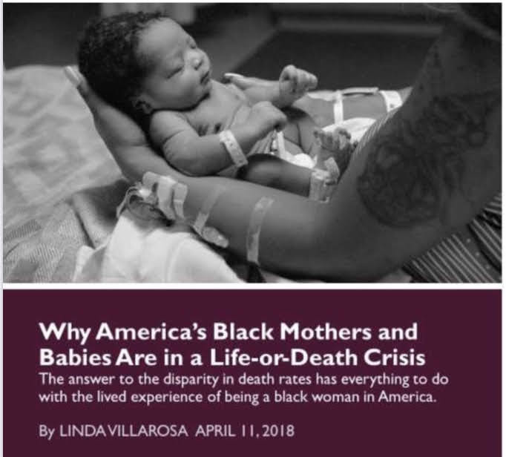
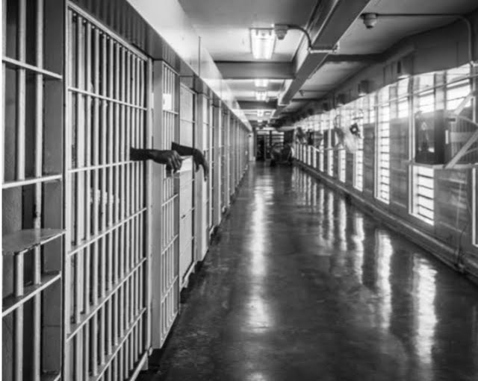
Racial equity is the goal.

